Slide 1
Eating well
LO: What does it mean to have a balanced diet?
Outcomes:
Name the 7 components of a healthy diet
Describe what makes up a balanced diet & give an example
Offer advice to patients on their dietary needs

Slide 2
Why are they so good?
http://www.youtube.com/watch?v=X7bj_LUIY7Y
Skip to the relevant part of the clip

Slide 3
What are the 7 components of a balanced diet?
Diet

Slide 4
Copy & complete the table
Food component | What we use it for | Where can we find it?
Protein
Carbohydrate
Fat
Fibre
Vitamins
Minerals
Water

Slide 5
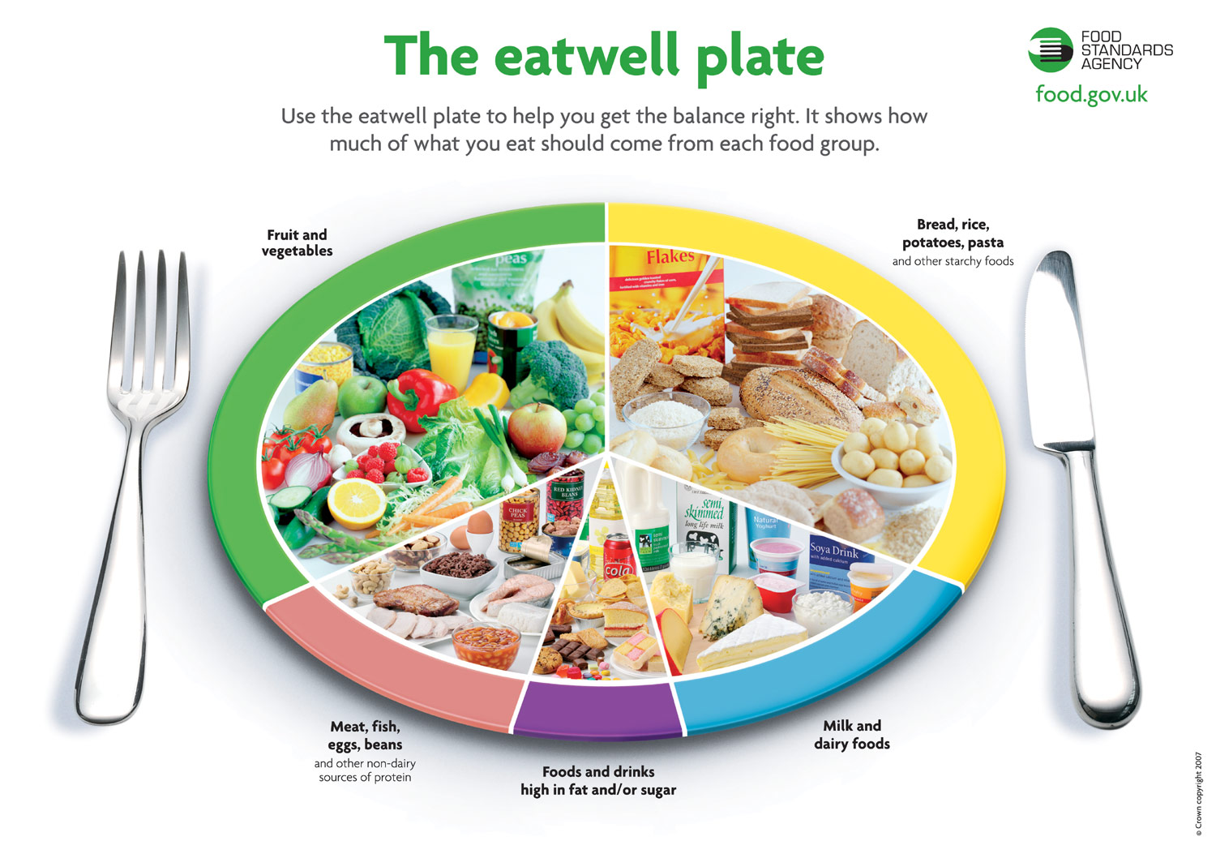
Notes:
Use the plate to devise a healthy meal plan for 24hrs

Slide 6
Group task
Use the patient cards to suggest improvements that could be made to their diets and lifestyle.
Get ready to present your findings to the class

Slide 7
Plenary
What did you do well this lesson?
What could you do better next time?

