Slide 1
Energy for fuel
LO:
How much energy do I need?
Outcomes:
Recognise that different groups of people have different energy demands
Interpret data on energy
Design their own lunch bar targeted at a group of people based on their energy needs

Slide 2
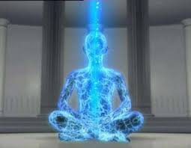
Notes:
Run laps of the classroom or act very energetically!

Slide 3
Use the activity cards to calculate the following energy requirements
How much energy is used completing 30 minutes of ironing and 30 minutes of brisk walking?
30 minutes of badminton and 1 hour of cleaning
45 minutes of moderate cycling and 1 hour f golf
15 minutes of tennis singles and 45 minutes of swimming
Design a series of activities that would require ……… KJ of energy

Slide 4
Produce a bar chart of energy demands and exersice

Slide 5
Notes:
Discuss

Slide 6
Design your own lunch bar

Slide 7
Presentations Extension task: complete Questions
Plenary:
WWW
EBI

