Slide 1
In the Bazaars of Hyderabad by Sarojini Naidu
Learning objective:
To develop our ability to analyse how setting and atmosphere are created using language.

Slide 2
Have you ever been to a market?
What did you see there?
What was it like?
Choose 5 adjectives that you would use to describe your experience in the market and be prepared to justify why you have chosen them.

Slide 3
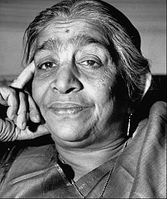
Now listen to the poem…
This is a poem describing a traditional market in Hyderabad, India. It was written by Indian poet Sarojini Naidu in the 19th century.
As you are listening to the poem, either jot down details, or sketch a picture of what you imagine this market to look like.

Slide 4
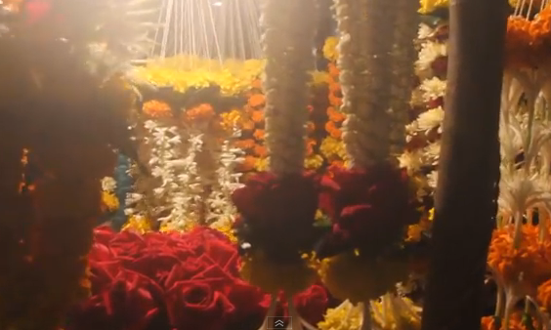
This is a video of a modern-day night market in India. In what ways is it similar/different to the market in the poem?
Click to view

Slide 5
This poem is a beautiful blend of sights, smells and sounds. What are they all?
Quotations relating to sight:
Quotations relating to smell:
Quotations relating to sound:

Slide 6
The poem follows a question and answer structure…why might this be? This is what we would call a lyrical poem – it has a musical quality about it. What is it that makes the poem seem musical? How does this affect the mood of the poem?

Slide 7
So…overall…how is a sense of setting and atmosphere created in In the Bazaars of Hyderabad?

