Slide 1
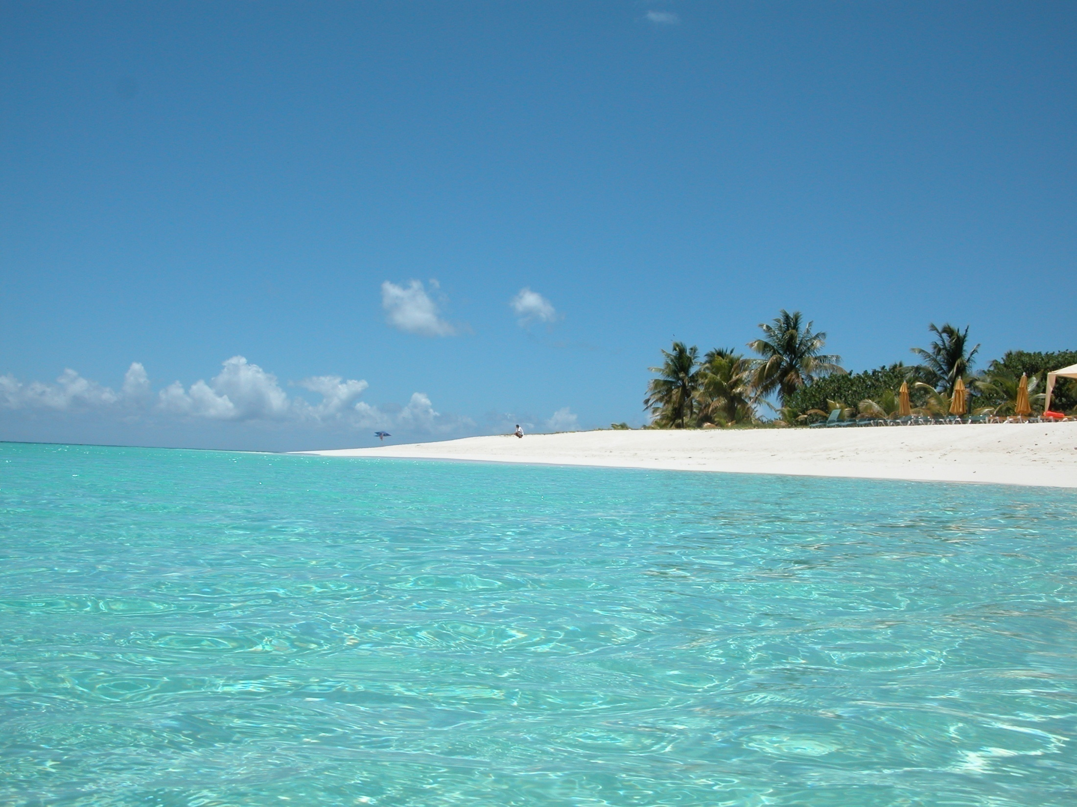
Island Man
By Grace Nichols
(for a Caribbean island man in London who still wakes up to the sound of the sea)

Slide 2
Where is the alliteration in this stanza and
what does this ‘hissing’ sound suggest?
The verb ‘wombing’ is made up! What does this bring to mind?
Morning
and island man wakes up
to the sound of the surf
in his head
the steady breaking and wombing
What is the significance of, ‘in his head’?

Slide 3
What particular memories does he have of his homeland?
Explain what is meant by the last line. Why is ‘groggily’ repeated?
wild seabirds
and fishermen pushing out to sea
the sun surfacing defiantly
from the east
of his small emerald island
he always comes back
groggily groggily
Can you spot some personification?
What word shows the strength of the man’s connection to his home?

Slide 4
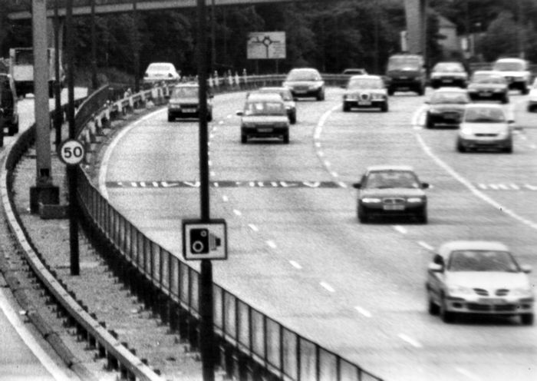
Which words and phrases show the contrast between his dream and the reality of London life?
Comes back to sands
of grey metallic soar
to surge of wheels
to dull North Circular roar
In what ways to ‘sands’, ‘soar’, ‘surge’ and ‘roar’ seem out of place in this stanza? Why do you think they have been used here?

Slide 5
What exactly is he trying to muffle?
How does the verb ‘heaves’ contrast with the mood of the first two stanzas?
muffling muffling
his crumpled pillow waves
island man heaves himself
Another London day.
How effective is the final line as an ending to the poem?

Slide 6
Themes
Homesickness
Nostalgia
Memories
Regret
Contrast between two worlds

