Slide 1

Keeping mentally healthy at home-a pack to help you.

Slide 2

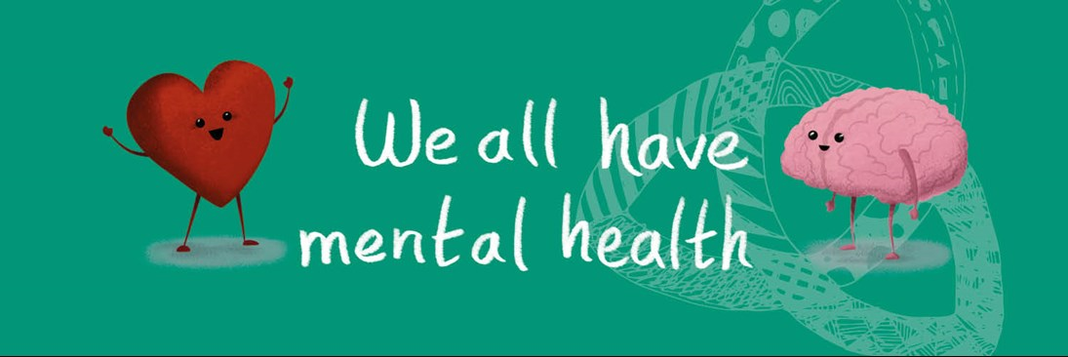
During home learning, social distancing or self-isolation, pay attention to your own wellbeing and that of those around you.

Slide 3
Remember we are all part of the school community
Keep in regular contact with your teachers, as much as possible at your regular lesson times.
Remember you are not alone. Your teachers are still available to support you, both academically and pastorally.
Ask for help when needed; independent learning is a new skill to learn. Don’t be afraid to say if something seems confusing or you need extra support.
Try to keep on top of your workload to avoid feeling overwhelmed.
Take the opportunity to also follow your passions; if a particular topic interests you, research it. You never know where it might lead! Be sure to keep your teachers updated so we can support you in this.
-take the time to learn a new hobby or skill, whether for development or just pure joy.

Slide 4

What wellbeing looks like
Interactions with family and friends
Healthy eating
Regular sleep patterns
Communicates with others
Work/ life balance
Other interests
Physical activity
All of these remain important during the period of home learning.
Notes:
Change in appearance: weight loss or gain, lack of self care, skin tone

Slide 5

Signs and symptoms to look out for
Change in sleep patterns
Becoming withdrawn
Friendship groups: can become less or more social than usual
Change in eating patterns
Change in appearance
Personality shifts
Problems with concentration

Slide 6
Wellbeing – What Parents/ Carers Can Do
Healthy eating
Encourage down-time
Create productive habits – work routines
Interactions/ listening
Good home/ school communication
Monitoring social media access
Be aware of important academic dates
No issue is too small!

Slide 7
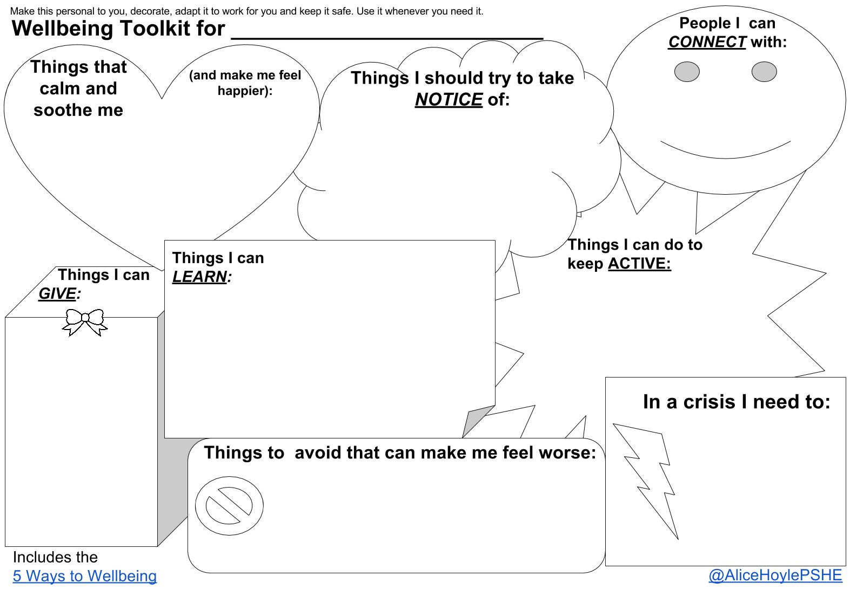

Slide 8


Build in structure

Slide 9
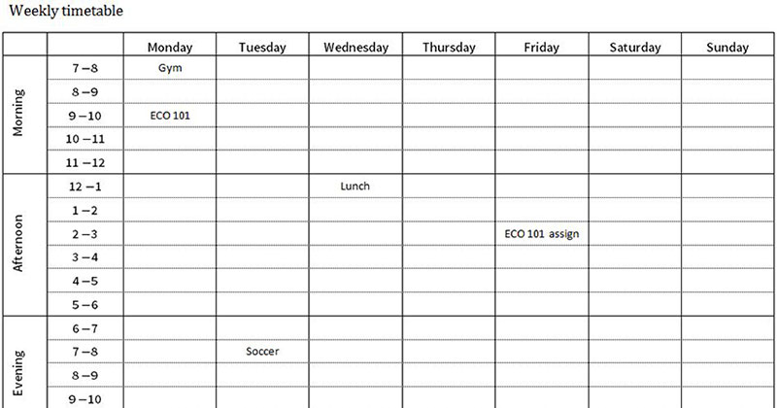
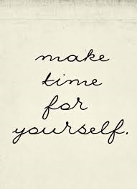
Build in structure
Try to maintain a routine similar to your normal day/ week (e.g., weekday and weekend routines)
Have allocated time for work and for rest and relaxation.
Maintain habits – dress in the daytime, eat lunch at the same time, incorporate break times.
Make time for what you love.
Break your day/ week into chunks
Plan your time.
Build in social contact; distance physically but don’t become socially isolated. Now is the time for Tik Tok and Face Time!

Slide 10
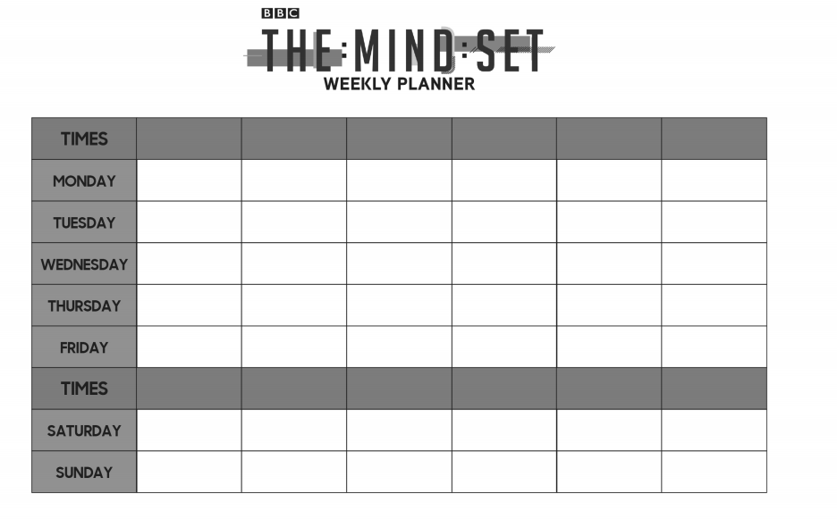

Slide 11
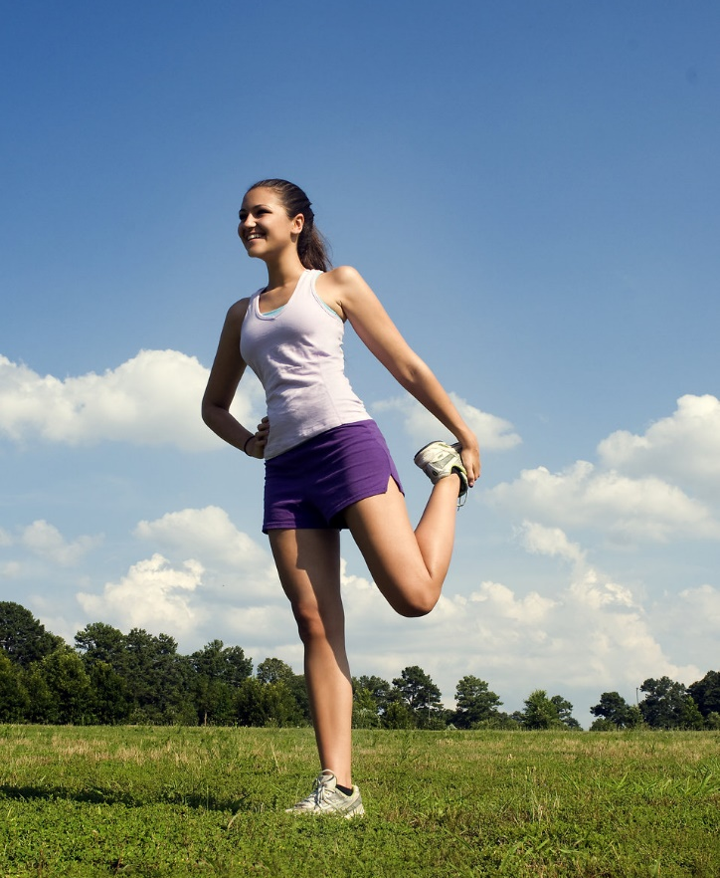
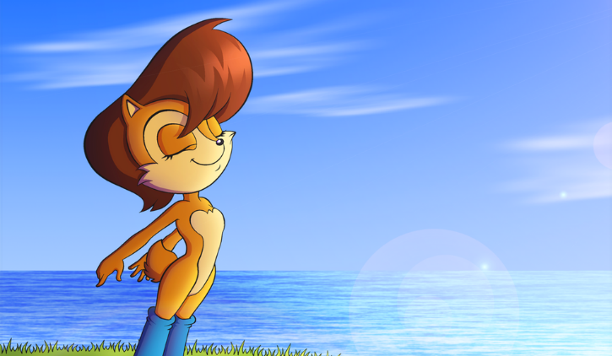
Remember the basics

Slide 12

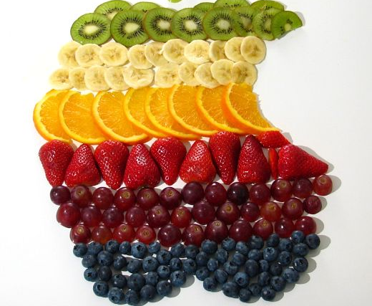
Basics
Get some fresh air*
Go outside, preferably in the mornings/ during daylight*
Exercise at regular points throughout the day. Joe Wicks is doing a PE lesson on Youtube, for example: https://www.youtube.com/watch?v=K6r99N3kXME
-Keep hydrated
Try to maintain regular meal-times
Eat a balanced diet
*If it is safe to do so and bearing in mind any medical advice.

Slide 13


Stay Connected
Physical distancing – not social distancing

Slide 14

Stay Connected
Make time to connect with family and friends online or virtually
Schedule regular catch ups – use Whatsapp, Facetime or Messenger Video calls
Make plans to “meet” – video calls for meals, cake, takeaways, etc.
Use appropriate technology wisely (eg Netflix watch parties, gaming apps with chat function) but safely and only with your own existing social circle.
Be kind – remember others may also be finding this situation challenging.
Why not try sending post to old people’s homes? Or send a letter of thanks to your local doctors or hospital?

Slide 15



Know where to go for extra help if you need it

Slide 16
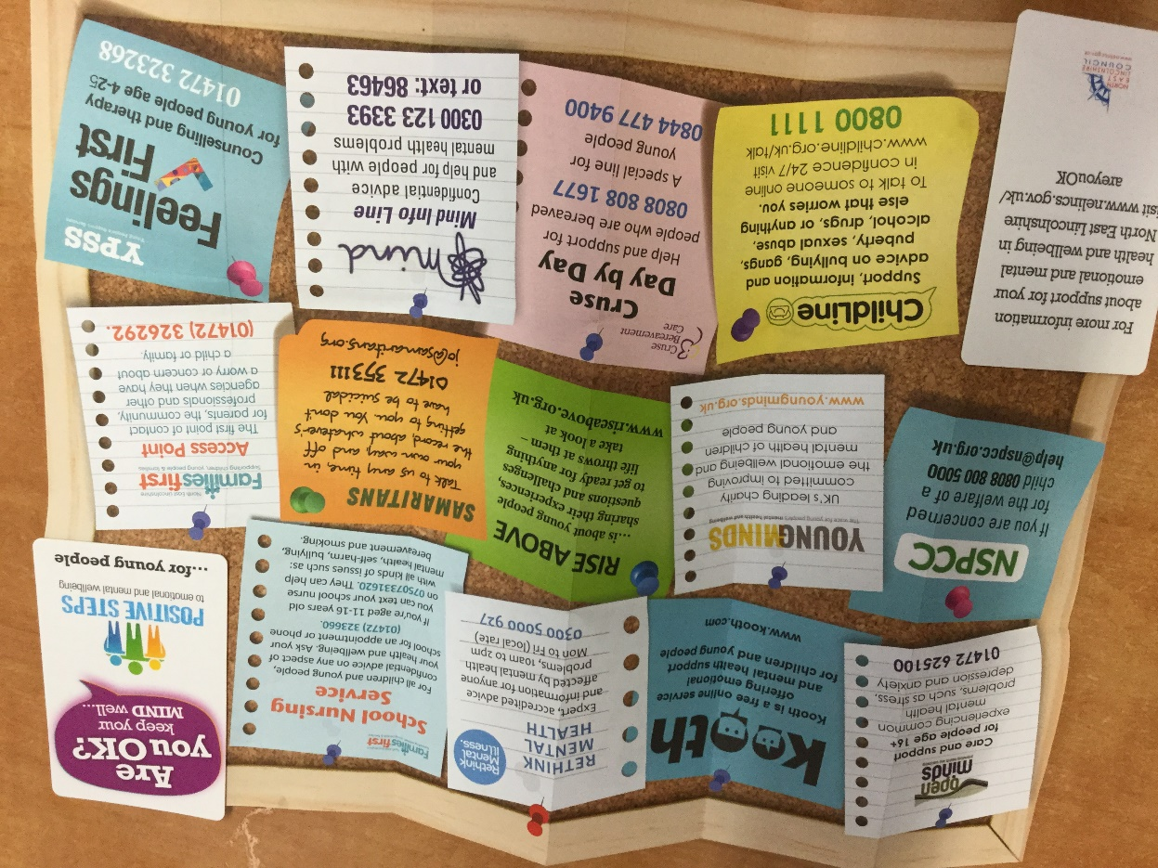
Where to go for help – some ideas

Slide 17


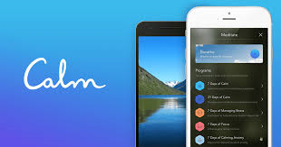

Tools and resources
Youtube – lots of guided meditations and mindfulness videos, music for relaxation/ concentration
Kooth app – online counselling and emotional well-being platform for children and young people, accessible through mobile, tablet and desktop
Calm app – guided meditations, daily reminders. School subscription.
BBC – specific programmes, podcasts and online resources to support pupils and parents during school closures
Shout! Text 85258 –counsellors available for free via text. https://www.crisistextline.uk/

Slide 18
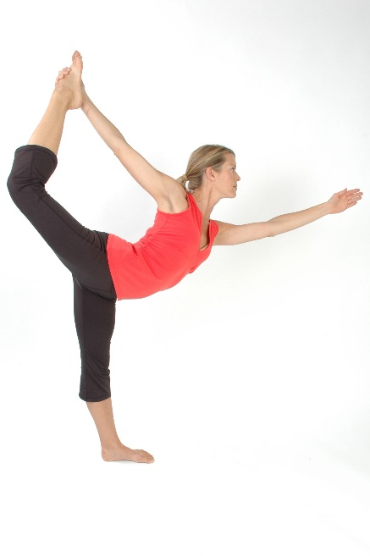
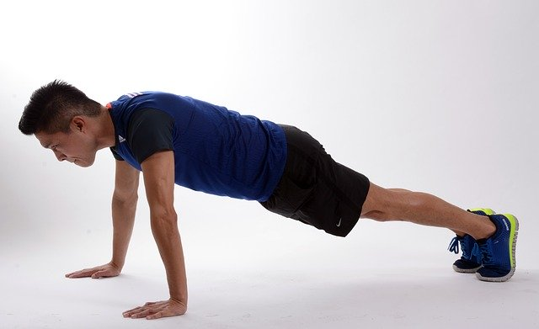
Keep moving

Slide 19

Keep Moving
Your daily activity will be reduced if you are at home, so it is important to build movement into your routine
Your usual exercise method may no longer be available
Use this opportunity to try something different
Youtube and other apps have tutorials and guided workouts-see Joe Wicks.
Try HIIT (High Intensity Interval Training), or more gentle exercises such as Yoga or Pilates
Go outside into the garden and play a game*
Take care not to injure yourself – work within your usual fitness levels and take it steady.
Have a virtual disco with friends or try an online Zumba class!

Slide 20
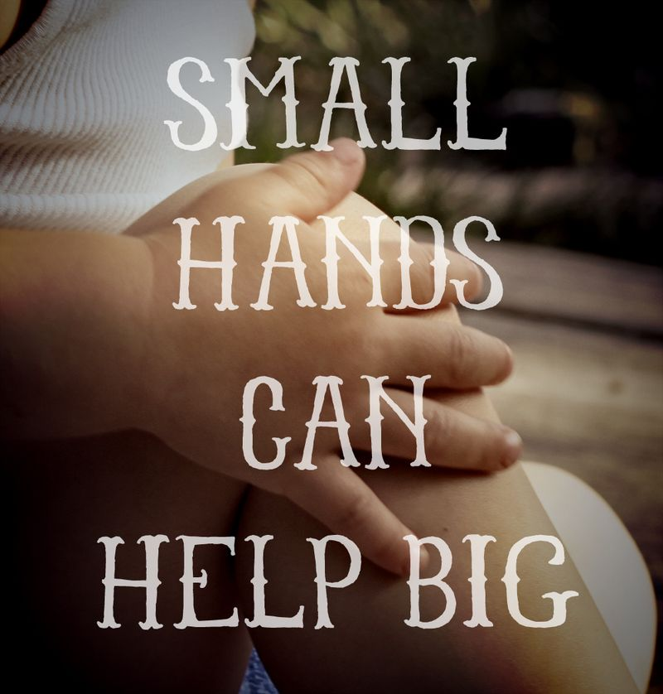

Make time meaningful

Slide 21


Make your time meaningful
All those things you never seem to have time for – list them!
Take up a new skill or hobby
Make time to be creative – art, music, crafts etc.
Make time to help others where possible, either virtually or, where safe to do so, in person; collect some shopping for a neighbour, offer to do some gardening for someone nearby, etc.
Keep up to date with study so you don’t feel overwhelmed

Slide 22


Mindful mandalas

Slide 23
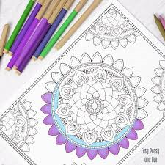

Mandalas/ mindful colouring benefits
Creative activities encourage flow
Slows breathing and heart rate
Allows self-expression
Time together
Can encourage “accidental” conversations
Provides a mental pause

Slide 24
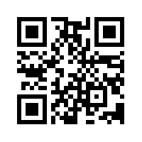
Try it… scan here for a link to mandala colouring ideas and downloads
Good things take time.

Slide 25



Music for relaxation and focus

Slide 26
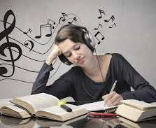

Music - benefits
Can reduce distractions
Sets a mood for concentration or relaxation
Can build routines
Reduces anxiety

Slide 27
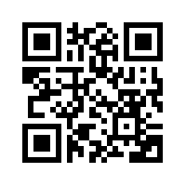
Try it… scan here for a link to music for relaxation
Everything is better with music.

Slide 28
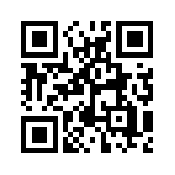
Try it… scan here for a link to Spotify playlists for focus
Music is what feelings sound like.

Slide 29

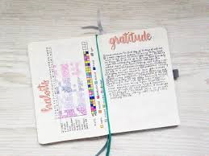
Journals and writing for wellbeing

Slide 30
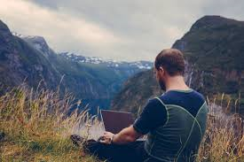

Journaling - benefits
Helps process emotions
Allows self-expression
Reduces stress and anxiety
Improves self-awareness
This is such a key moment in time, in years to come you will read back your words and be grateful that you documented it. You could do an online journal such as Penzu.

Slide 31
Journaling prompts – some ideas
The main thought in my head today was…
Right now I feel challenged by…
I feel supported when…
I am grateful for…
One thing I could do to help myself today is…
What I want to say to my anxious thoughts…
Write your anxious thoughts that include words like “never,” “always,” “everyone,” and “no one.” Circle those you can prove are 100% true

Slide 32
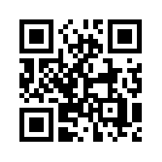
Try it…
scan here for a link to journaling ideas
Fill the paper with the breathings of your heart.
William Wordsworth

Slide 33
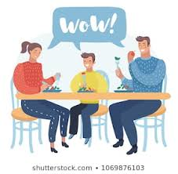
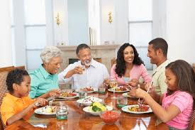
Keep talking

Slide 34
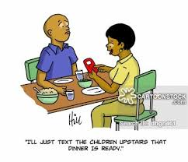
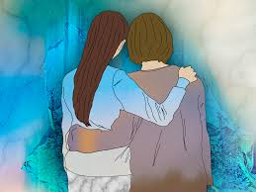
Talking - benefits
Improves relationships
Identifies potential problems early
Builds self-esteem
Generates problem-solving ideas together

Slide 35
Who did you eat lunch with today?
What is your favourite song right now? Why?
What has made you smile/ frustrated/ confused today?
Has anyone around you had a hard time today?
If you could do anything this weekend/ next holiday, what would you choose?
What are you most looking forward to right now?

Slide 36
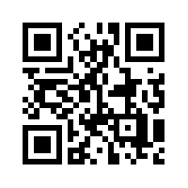
Try it…
scan here for a link to conversation starters.
Every good conversation starts with good listening.

Slide 37
Remember we are all part of the school community
we are still here for you.
We are still working for you.
We want to help you wherever possible.
YOU ARE NEVER ALONE. WE ARE ALL A COMMUNITY TOGETHER.

