Slide 1
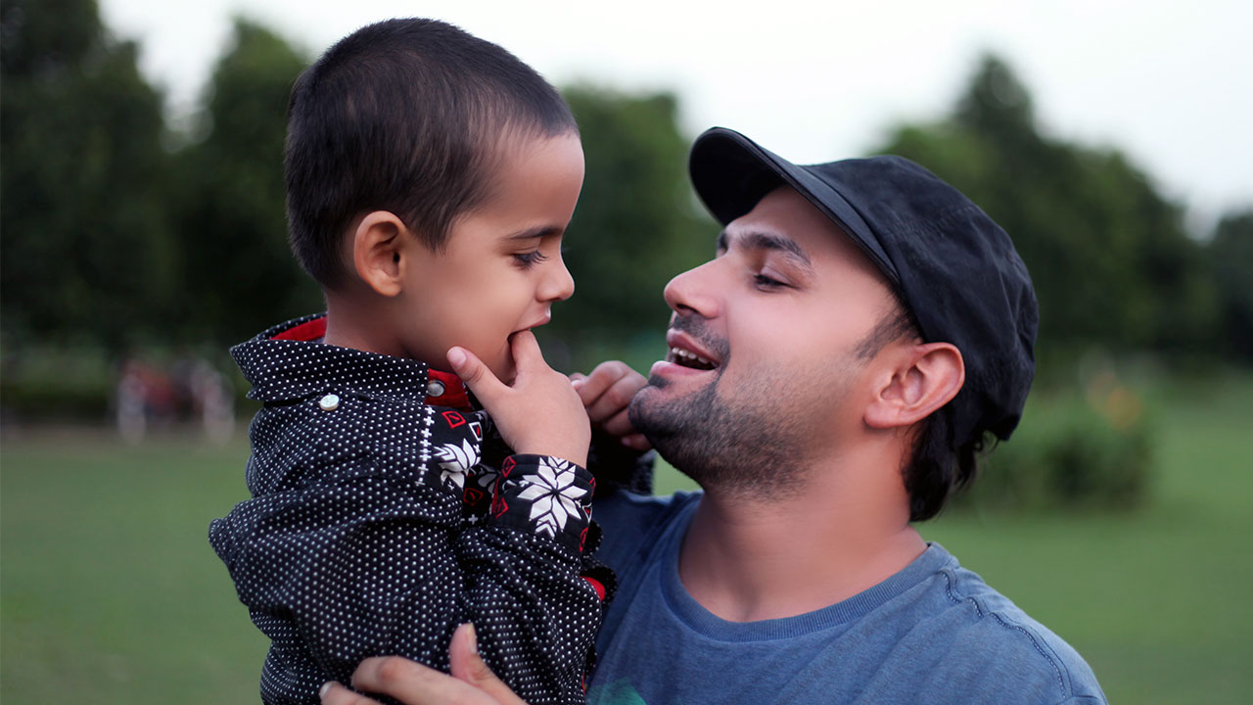
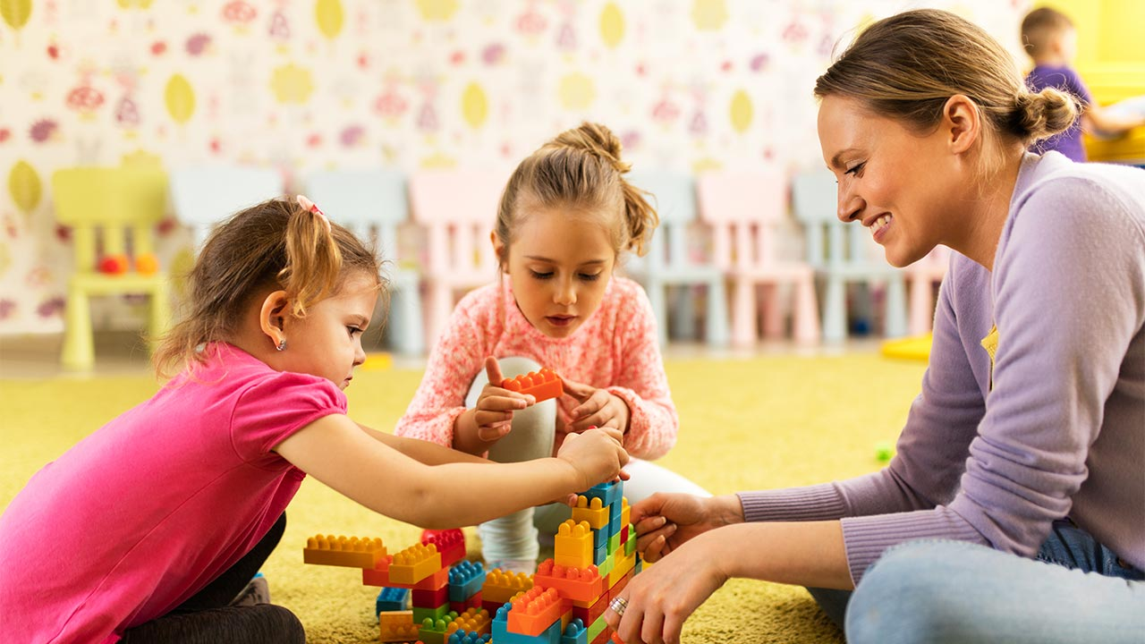
Level 1 / 2 Child Development
KEY TEACHERS: Mrs Derwent, Mrs Burton & Mrs Wood HEAD OF DEPT: Mrs Derwent

Slide 2
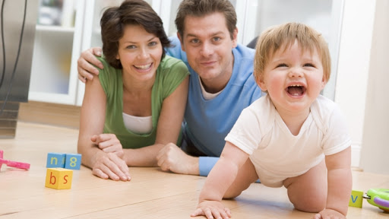
WHAT YOU WILL LEARN
Health and well-being for child development
Create a safe environment and understand the nutritional needs of children from birth to five years
Understand the development of a child from one to five years

Slide 3
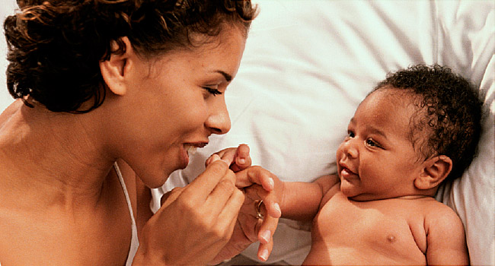
WHAT YOU WILL LEARN - Unit R057: Health and well-being for child development
Pre-conception health and reproduction
Antenatal care and preparation for birth
Postnatal checks, postnatal care and the conditions for development
Childhood illnesses and a child safe environment

Slide 4
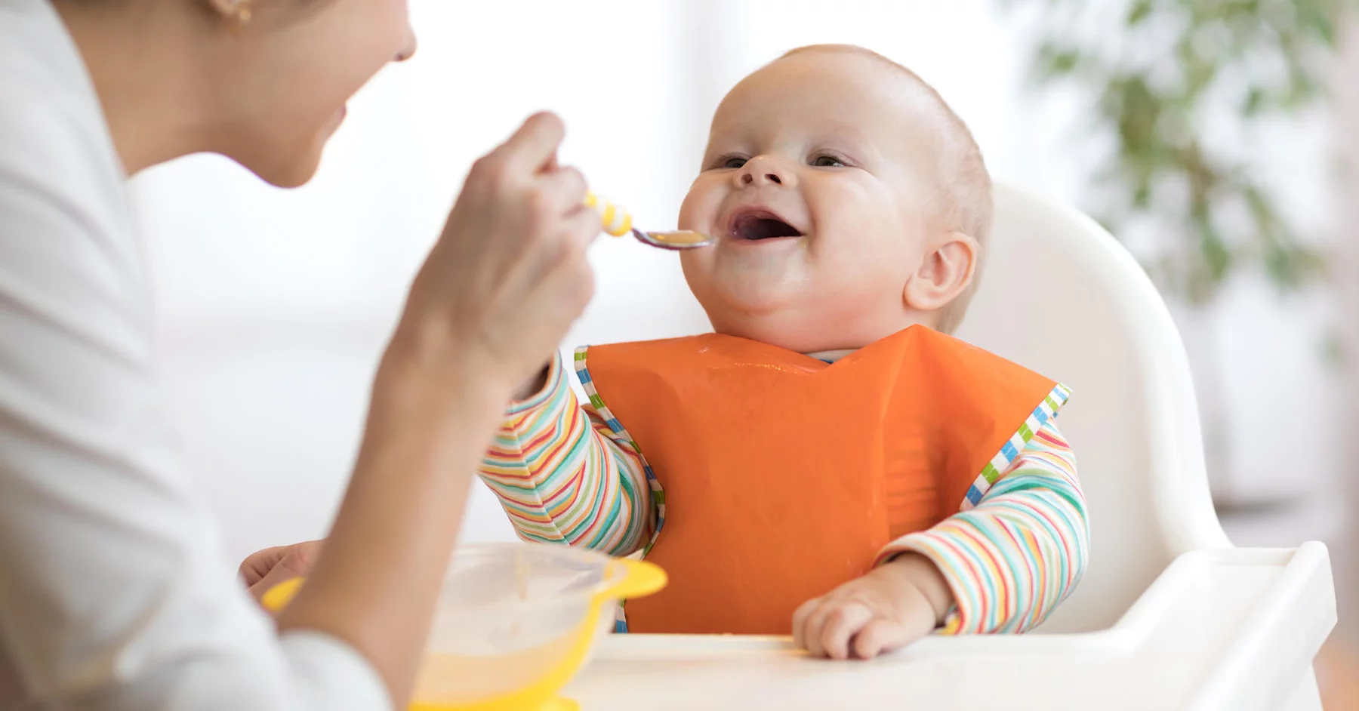
WHAT YOU WILL LEARN - Unit R058: Create a safe environment and understand the nutritional needs of children from birth to five years
Creating a safe environment in a childcare setting
Choosing suitable equipment for a childcare setting
Nutritional needs of children from birth to five years

Slide 5
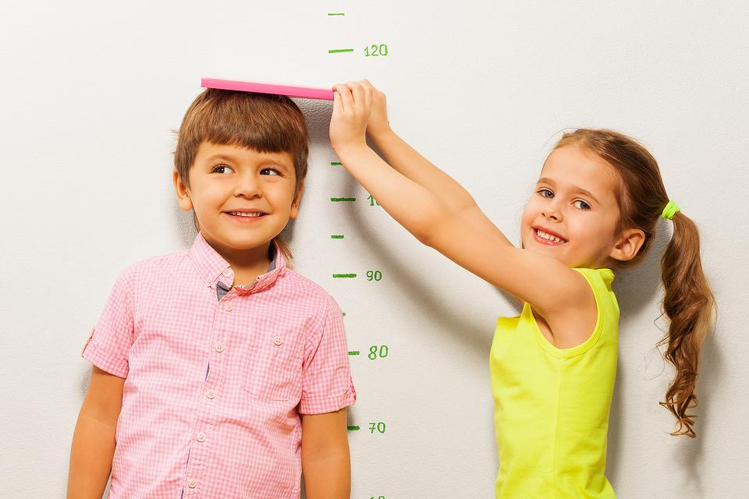
WHAT YOU WILL LEARN - Unit R059: Understand the development of a child from one to five years
Physical, intellectual and social developmental norms from one to five years
Stages and types of play and how play benefits development
Observe the development of a child aged one to five years
Plan and evaluate play activities for a child aged one to five years for a chosen area of development

Slide 6
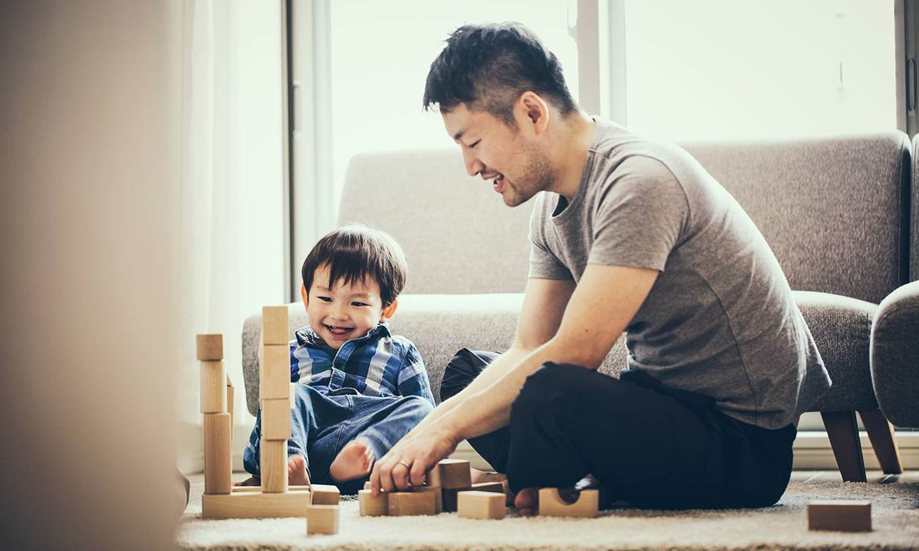
WHAT YOU WILL DO IN A SEQUENCE OF LESSONS – Course Breakdown
Year 10 / 11 – 3 Lessons per week (usually one double and one single)
Develop understanding of topics through theory lessons throughout both years
Complete ongoing assessments independently during class time
Revision for exam

Slide 7
WHAT YOU WILL DO IN A SEQUENCE OF LESSONS – FAQ’s
What are the similarities and differences between a Cambridge National qualification and a GCSE?
Ongoing assessments throughout both years, rather than solely assessed at the end of Year 11
GCSE qualifications and Cambridge Nationals are Level 1 and 2 qualifications. Worth the same ‘points’ as a GCSE eg. Level 2 Distinction = 7 at GCSE, Level 2 Pass = 4 at GCSE
What's the qualification like?
We learn a lot through talking about the subject together. However, there is quite a bit or writing, lots of exam based questions and homework tasks set. Many students that take child development enjoy the conversational element, but also work well independently due to the heavy coursework element of the course.
Does this subject take up a lot of studying time?
You can choose to add more study time into the subject if you wish. As there is a written exam we will complete lots of past papers etc to keep on top of revision. Most topics cross-link with other topics on the course so there is some repetition to help with studying and boosting coursework. You will be expected to work hard and complete your one hour per week of homework – it is a Level 1 / 2 qualification after all!
Do we do any practical work?
Sadly, we do not arrange work placements for you. You are encouraged to try and get a job in a childcare setting or even babysitting as this will all help with your experiences, adding to your understanding and practical application of the course. In Year 11 you will need to ‘study’ a child by creating some activities for them to complete. It would help to have access to a child for this purpose, so the more you get to know them leading up to year 11 the easier this task will be.

Slide 8
HOW YOU WILL BE ASSESSED
Three Units
R057: Health and well-being for child development
Exam Paper
Duration 1 hour and 15 minutes
Worth 70 marks / 40% of qualification
Unit R058: Create a safe environment and understand the nutritional needs of children from birth to five years
Controlled Assessment completed in lessons (4 tasks)
Worth 60 marks / 30% of qualification
Unit R059: Understand the development of a child from one to five years
Controlled Assessment completed in lessons (2 tasks)
Worth 60 marks / 30% of qualification

Slide 9
WHAT SKILLS YOU WILL DEVELOP AND WHERE THOSE SKILLS MIGHT TAKE YOU - Why study Child Development?
The Course
Lots of group conversations
Independent and team work opportunities
Assessed through exam and coursework
Skills
Communication
Analysis and Evaluation
Organisation
Hygiene and Safety
Note
You will need to be good at working independently and managing your time well

Slide 10
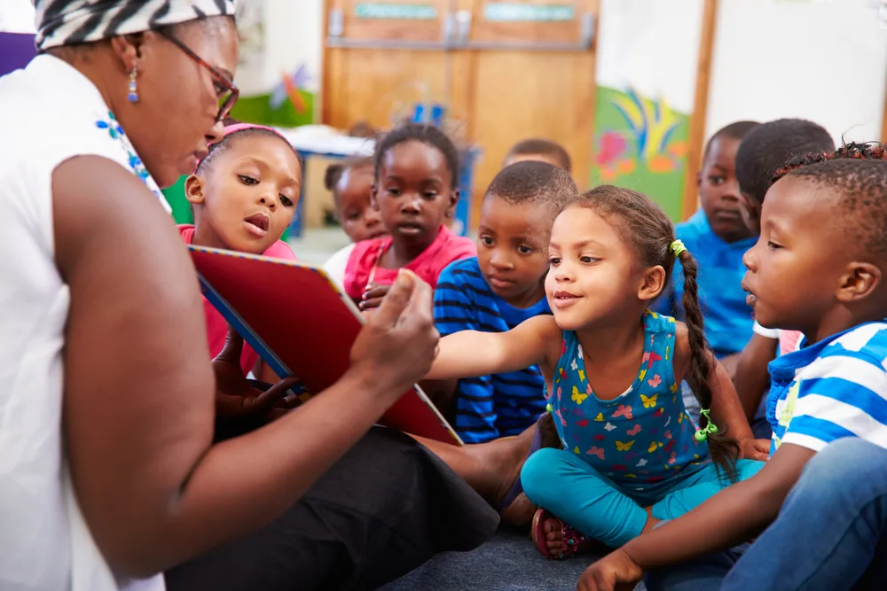
WHAT SKILLS YOU WILL DEVELOP AND WHERE THOSE SKILLS MIGHT TAKE YOU - Student Testimonials
“I chose this subject as I would love to go into a career with children, my dream career is a nursery teacher.
Child development has given me a different subject perspective, in the sense that you’re learning about life and you know you are going to use it someday. I have loved learning about the development and growth of children, I have enjoyed the fun activities, and if you listen well it is an easy subject to understand. I have worked so hard on this course and the homework definitely helps to boost your knowledge and keeps it fresh in your mind, along with giving you a sense of achievement when tasks have been completed. It has given me confidence and is rewarding, along with giving me an insight into lots of career options ranging from nursery teaching to becoming a nanny. I plan to use my hard work and go into a workplace where I can apply this knowledge and continue being rewarded.”

Slide 11
WHAT SKILLS YOU WILL DEVELOP AND WHERE THOSE SKILLS MIGHT TAKE YOU - Life after Level 1 / 2 Child Development
6th form at DSHS – Health and Social Care
College
Apprenticeships
University
Abundance of career opportunities

Slide 12
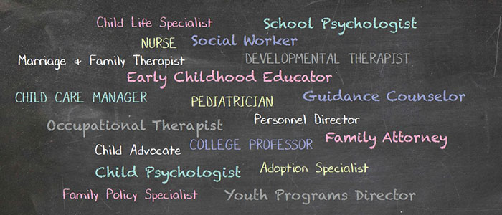
WHAT SKILLS YOU WILL DEVELOP AND WHERE THOSE SKILLS MIGHT TAKE YOU - Potential careers
What jobs will this help us get in the future?
You could look at it from a 'transferable skills' point of view. By doing a qualification in child development you are showing potential employers that you are creative, hard working, independent, motivated, practical, patient, can work well independently and as part of team. It shows you are not just good at writing answers on an exam paper.
Potential Careers
People will always need babies and young children to be taken care of however, this qualification can also be great for people choosing a career in teaching, paediatrics, health and social care, entertainment and hospitality.

Slide 13
We look forward to welcoming you on our course. We are happy to answer any questions you may have
Sarah Derwent - Head of Home Economics | Rachel Burton – Classroom Teacher | Jen Wood – Classroom Teacher
DerwentSS@droitwichspahigh.worcs.sch.uk | BurtonRS@droitwichspahigh.worcs.sch.uk | WoodJE@droitwichspahigh.worcs.sch.uk

